Slide 1
Text Analysis on the reviews data of Amazon Bestsellers in Smartphones
Arnab Kumar Gogoi
19BM61K27

Slide 2
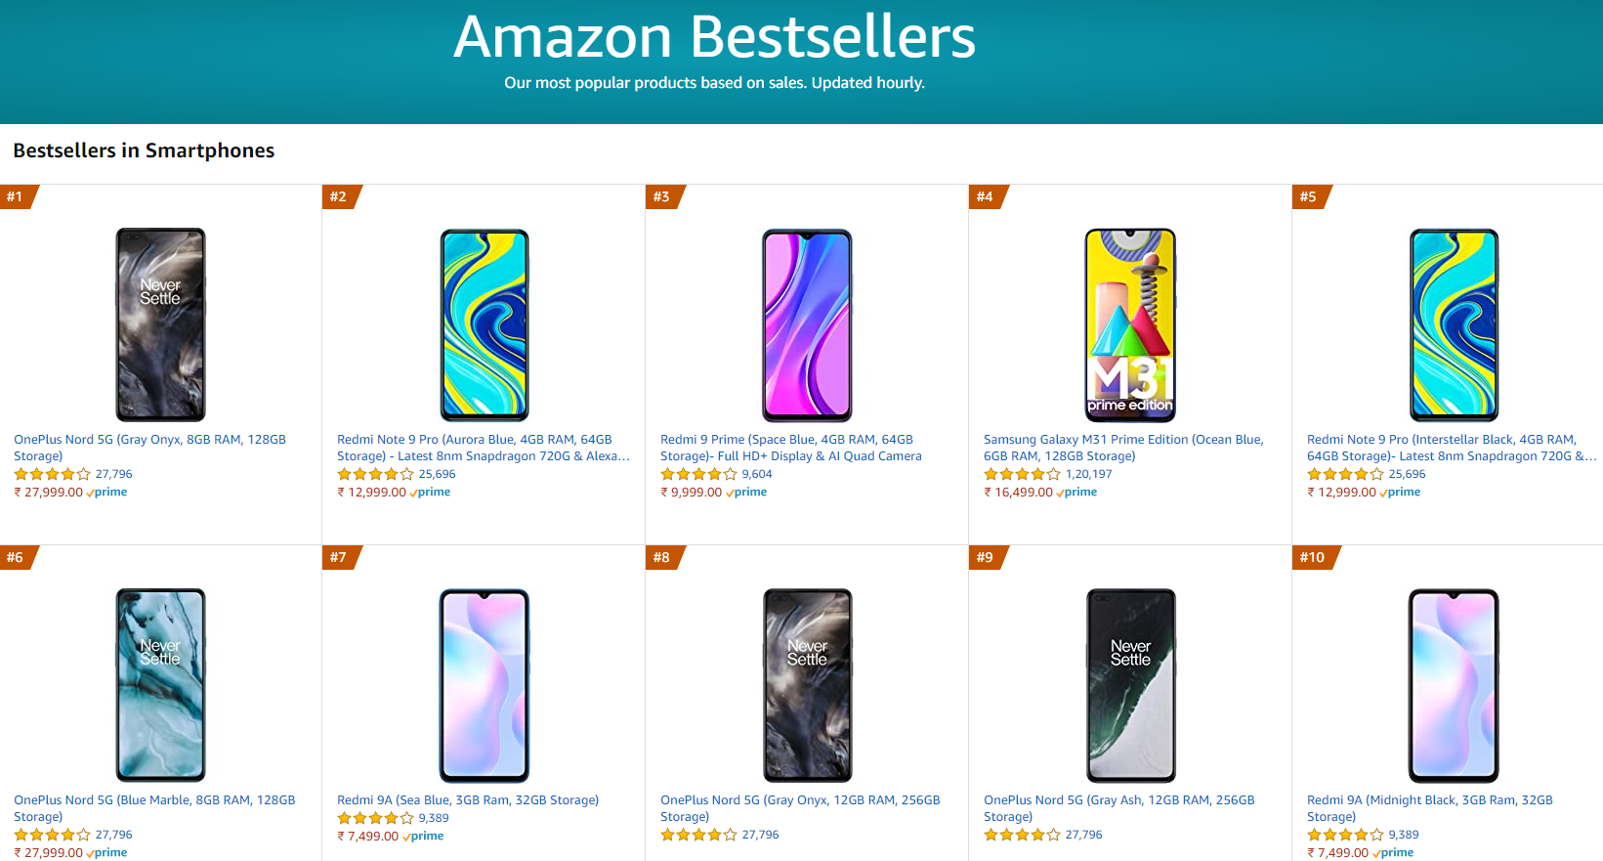
Project details
Amazon Page: https://www.amazon.in/gp/bestsellers/electronics/1805560031?pf_rd_r=7SFFM5A28RZH8PY7QAJG&pf_rd_p=dc57a140-9455-43df-8aed-3c1736b2f3d3
Total items: 100
Information on this page:
Product name
Rating out of 5
No of reviews received
Price
Link to product page
Link to review page

Slide 3
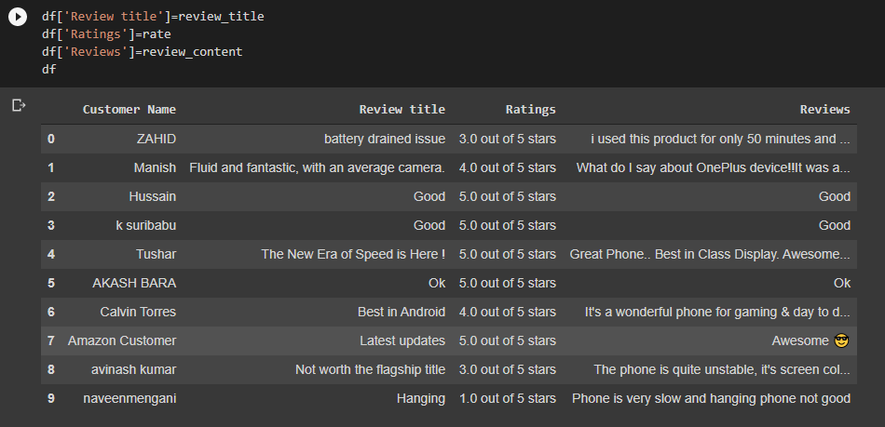
Scrapping the data:
Attempt1: Using BeautifulSoup HTML parser:
Web Scrapping Amazon Product Reviews OnePlus 8.ipynb
OnePlus.csv
Result: 10 reviews (Customer Name, Review Title, Ratings, Reviews)
Limitations:
Can extract 1 page at a time
Not automated for multiple products

Slide 4
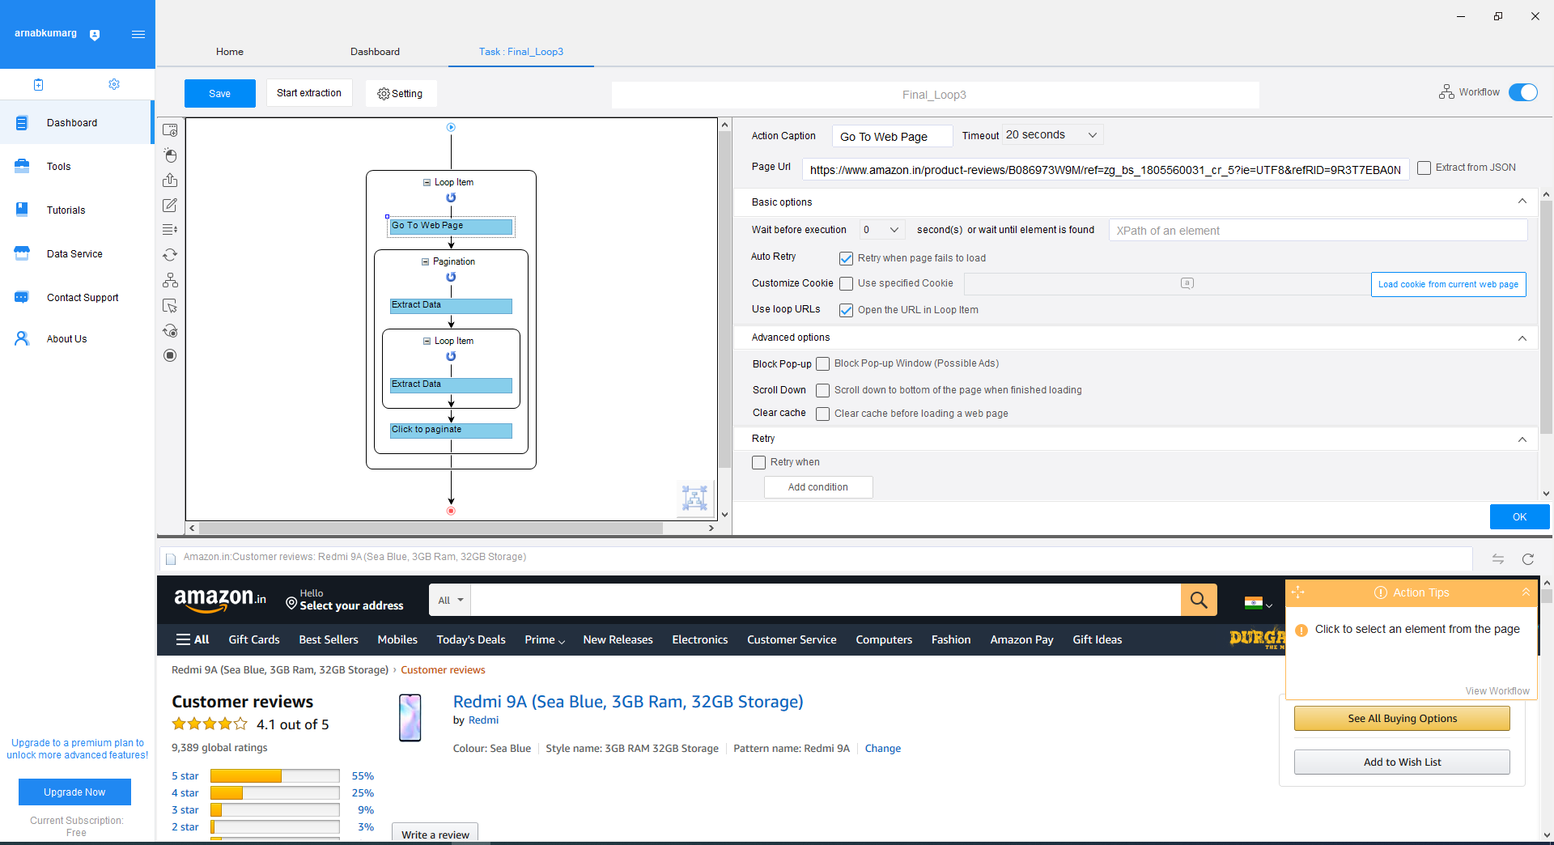
Scrapping the data:
Attempt2: Using Octoparse:
Flow:
Click on each review link on Amazon best seller page
Loop next button
Loop select reviews and extract elements
Cancel after 1000 reviews each product
Delete duplicates

Slide 5
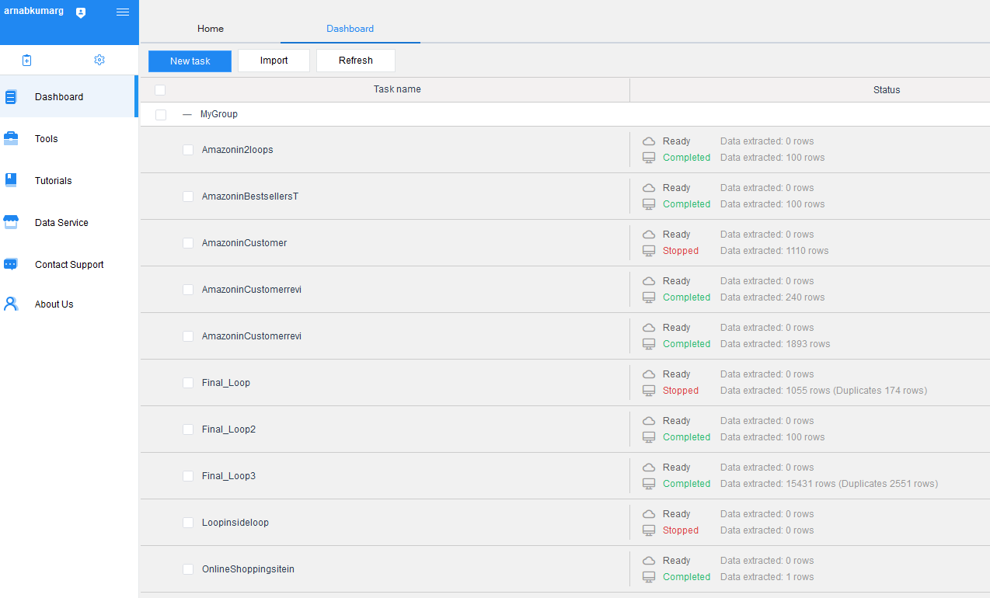
Scrapping the data:
Attempt2: Using Octoparse:
Amazon Bestseller Smartphones.csv
Result: 31,673 reviews from different products
Limitations:
Paid after 10 tasks
Paid if outputs is more than 1000 in one task, had to stop before reaching 1000, save and run again

Slide 6
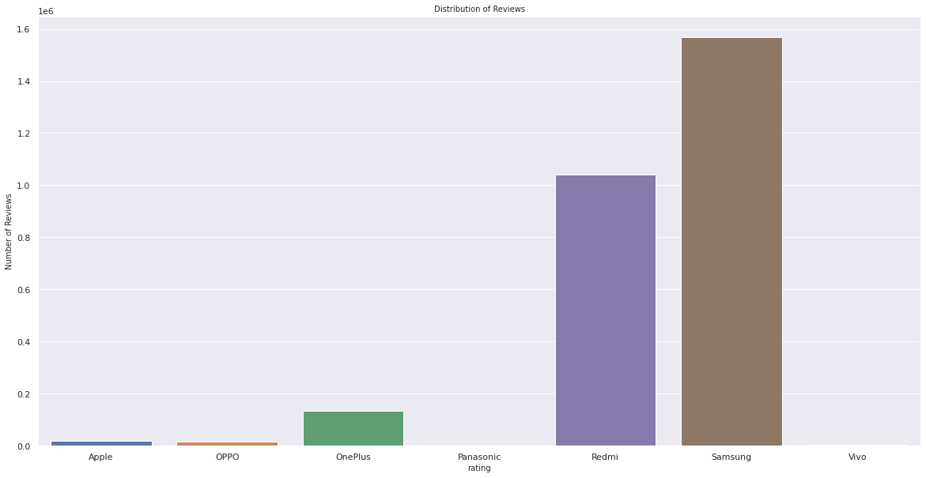
Analysis of Amazon 100 Bestsellers page:
Attempt2: Using Octoparse:
Amazon100Besteselllers.ipynb
No of total products: 100
Unique Models that share reviews: 33
Unique Brands: 7
Number of reviews per brand:
Apple: 20431
Oppo: 16890
OnePlus: 133689
Panasonic: 677
Redmi: 1041009
Samsung: 1569569
Vivo: 2956

Slide 7
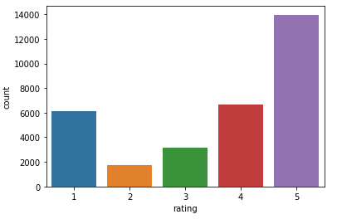
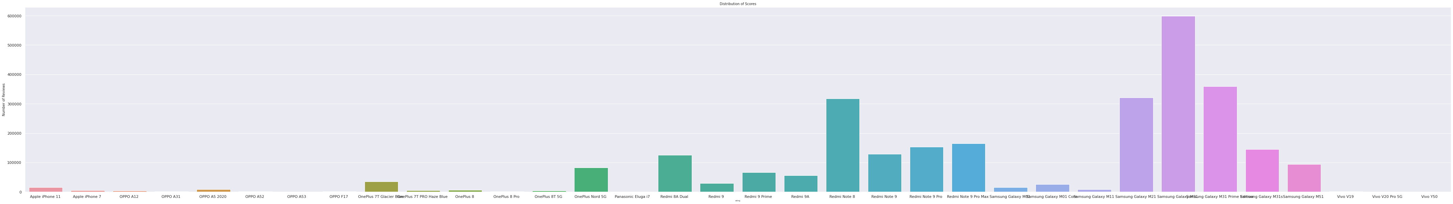
Analysis of Scrapped review data
DLS Project analysis.ipynb
Review counts and models:
Highest review: Samsung Galaxy M31, M31 Prime and M21
2nd Highest review: Redmi Note 8, Note 9
3rd Highest review: OnePlus Nord 5G
Distribution of the rating column: We can see that maximum reviews correspond to rating 5.

Slide 8
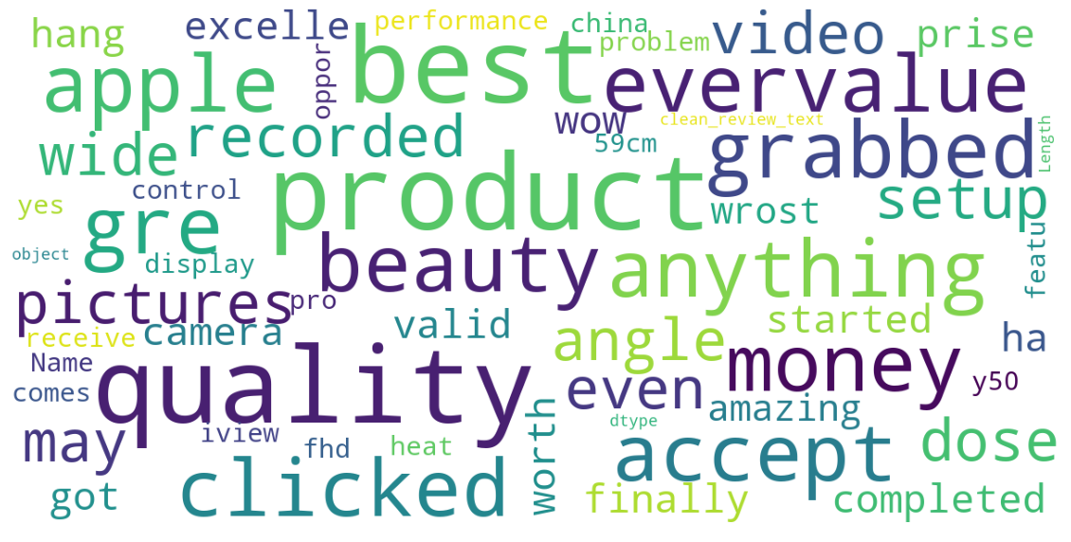
Text analysis with NLTK and Vader Sentiment analyzer: Positive reviews
Wordcloud for positive reviews shows words best, product, quality, beauty, money, grabbed, apple

Slide 9
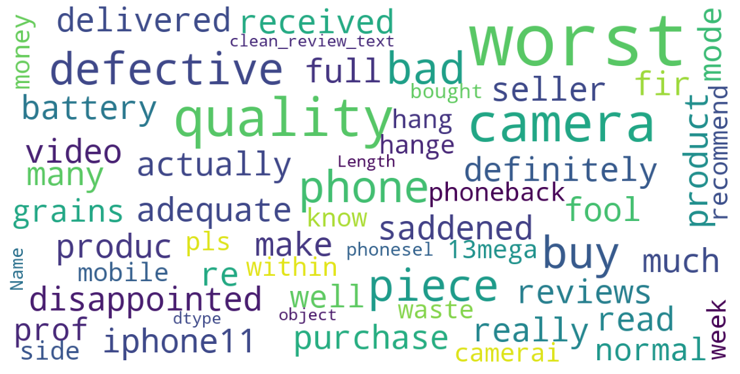
Text analysis with NLTK and Vader Sentiment analyzer: Negative Reviews
Wordcloud for negative reviews shows words worst, camera, quality, defective, disappointed

Slide 10
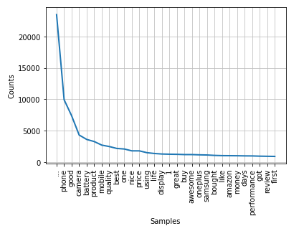
Text analysis with NLTK and Vader Sentiment analyzer
Frequency Distribution: Top tokens like product, good, camera, battery etc.

Slide 11
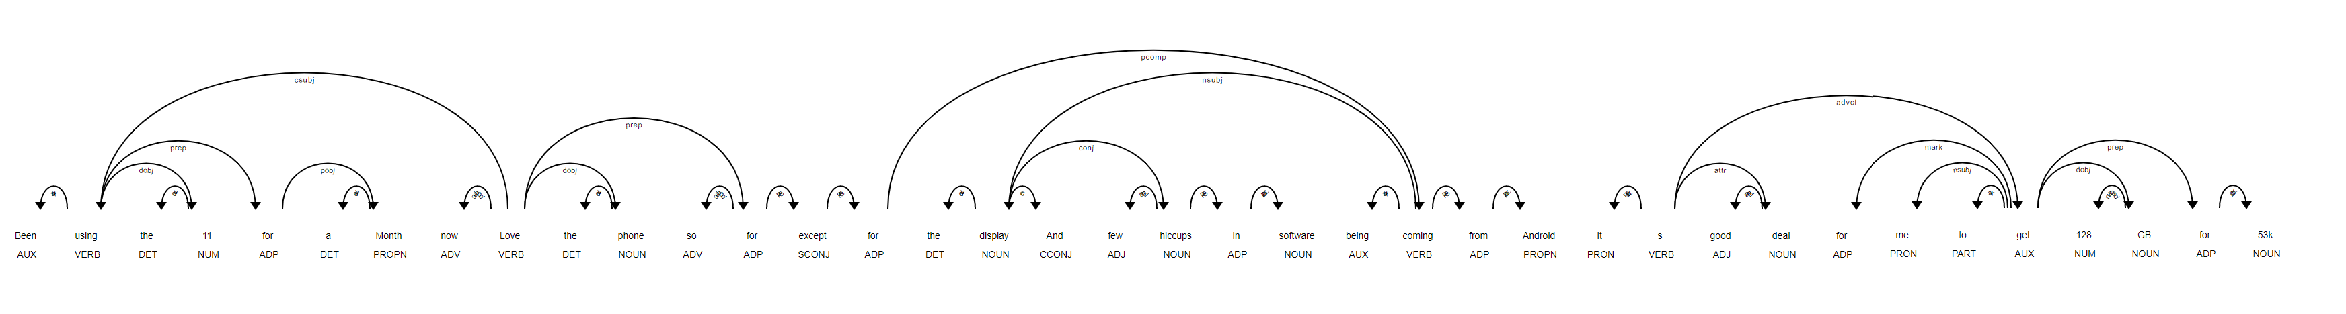
Review text analysis with spacy library
dependency parse tree or named entity visualization

Slide 12
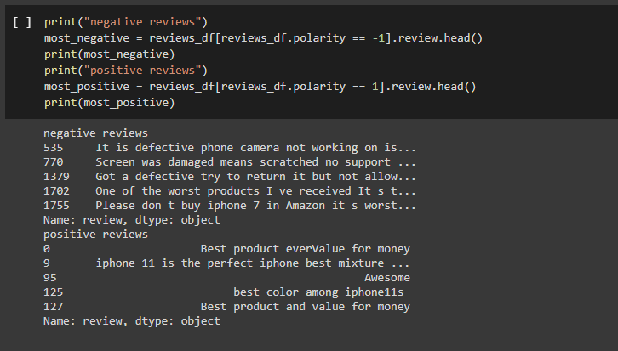
Analyzing with TextBlob

Slide 13
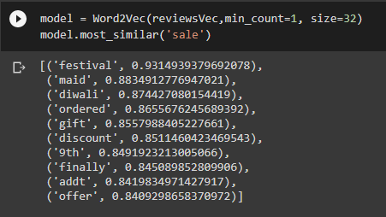
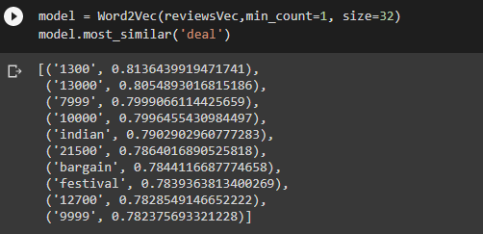
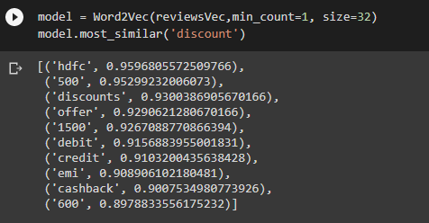
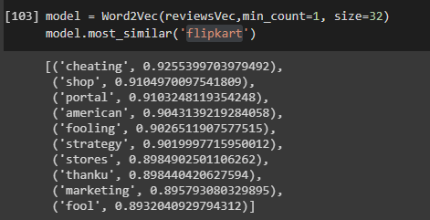
Text analysis with gensim and word2vec
Using the trained model to find the similarity of certain word.

